Slide 1
Mission Trip to Hammond Louisiana
Ranchos Presbyterian Church
Young Adults
January 3 – 13, 2017

Slide 2
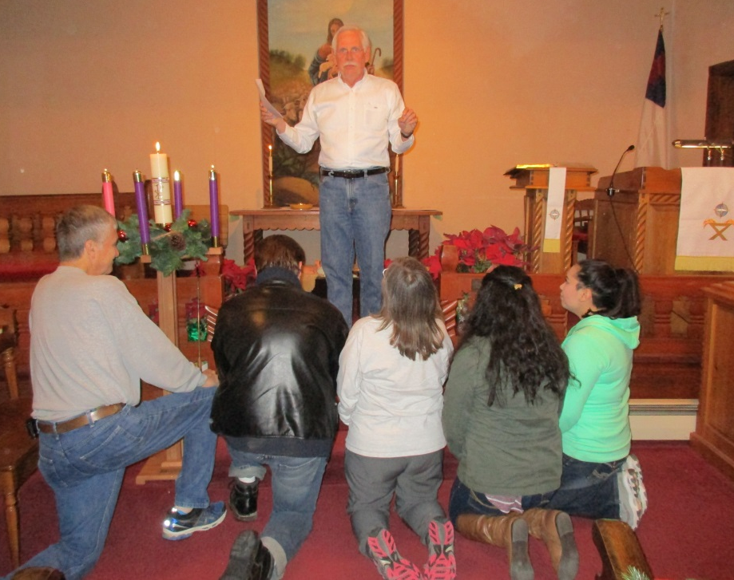
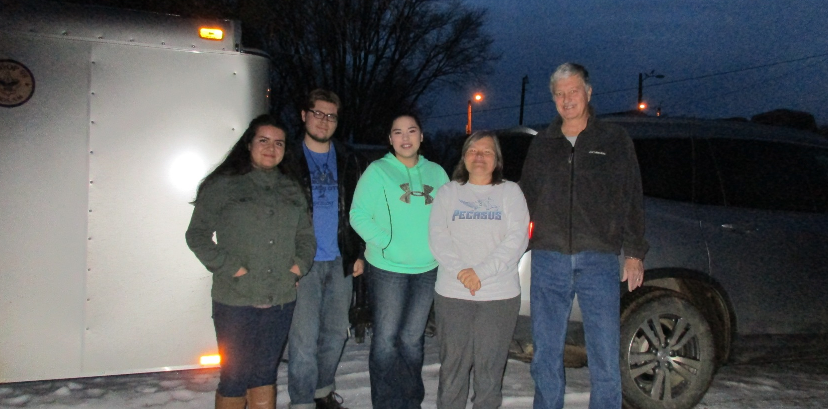
Sending Ceremony and Packed Up

Slide 3
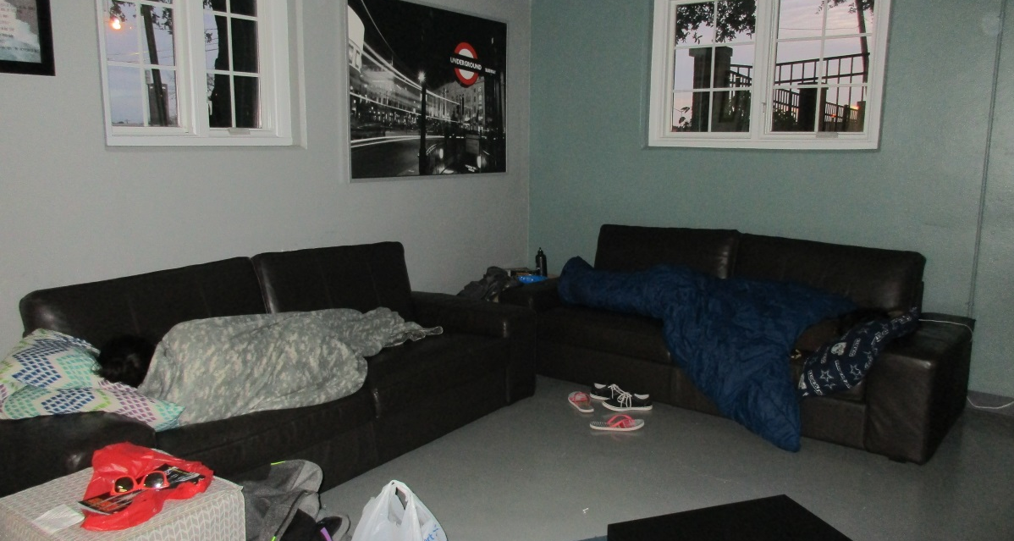
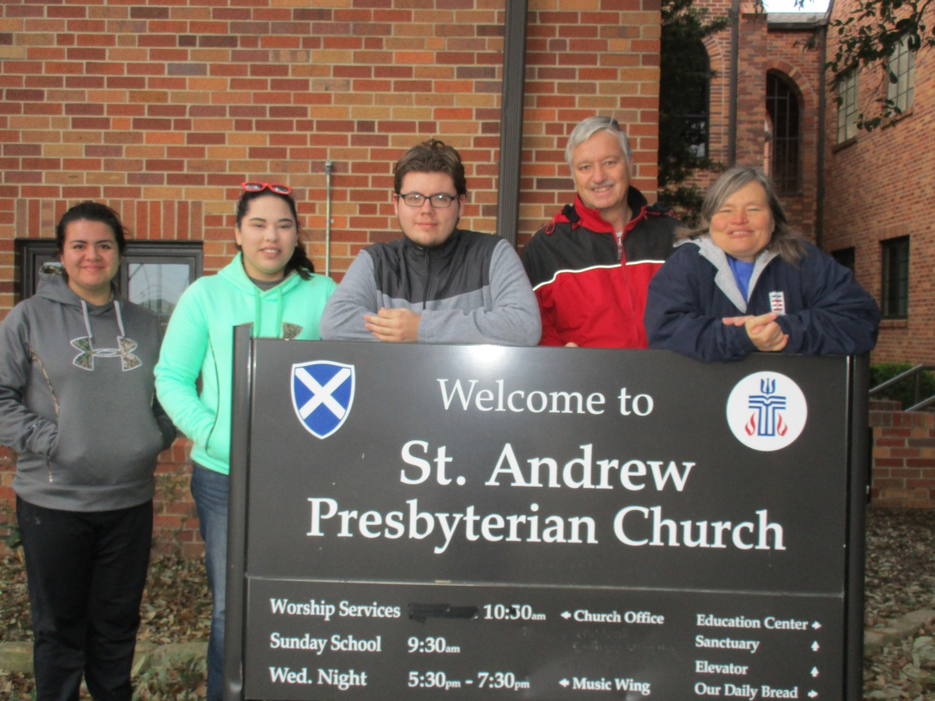
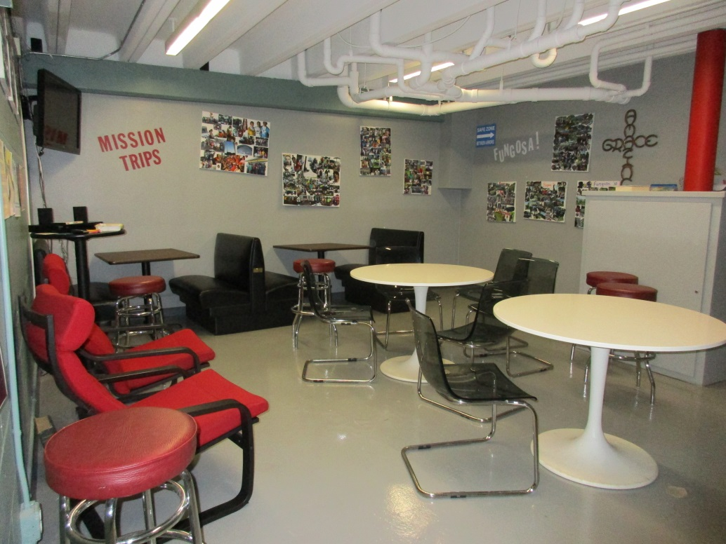
Overnight St. Andrew Presbyterian Church Denton, TX
Val & Regan –
lumps on the
couches
Youth
Lounges

Slide 4
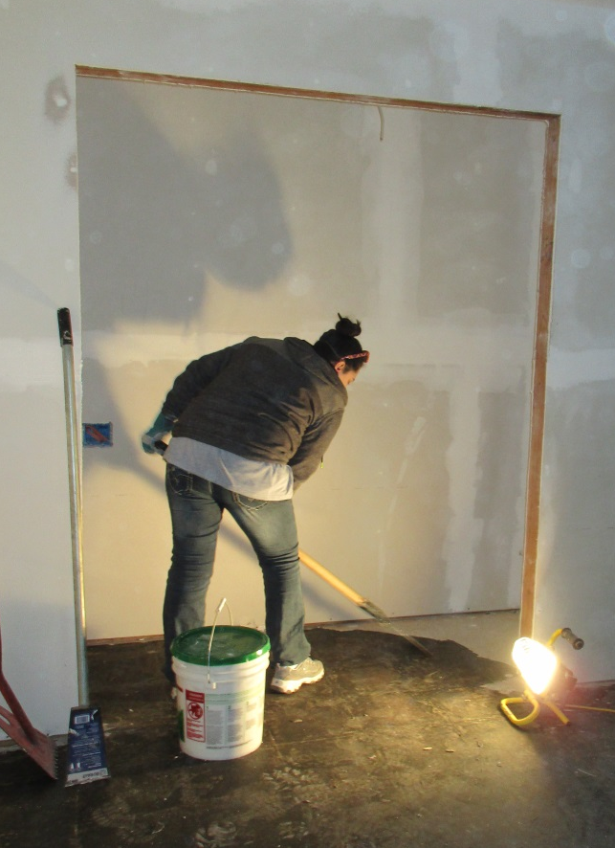
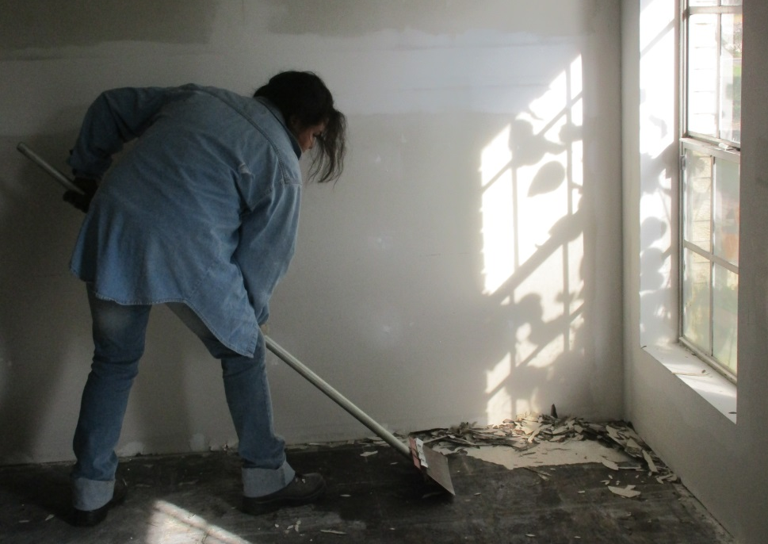
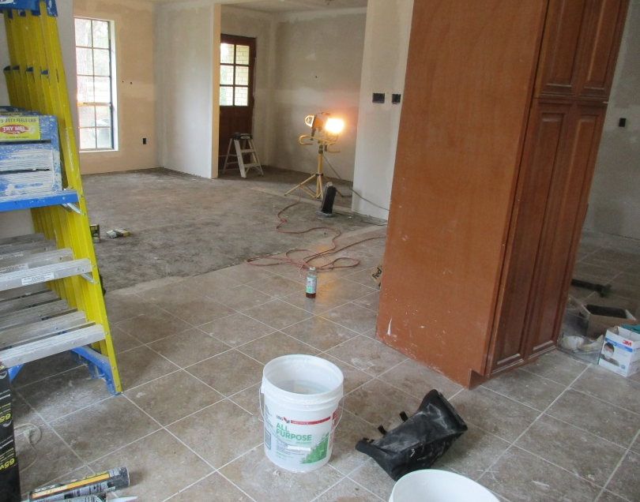
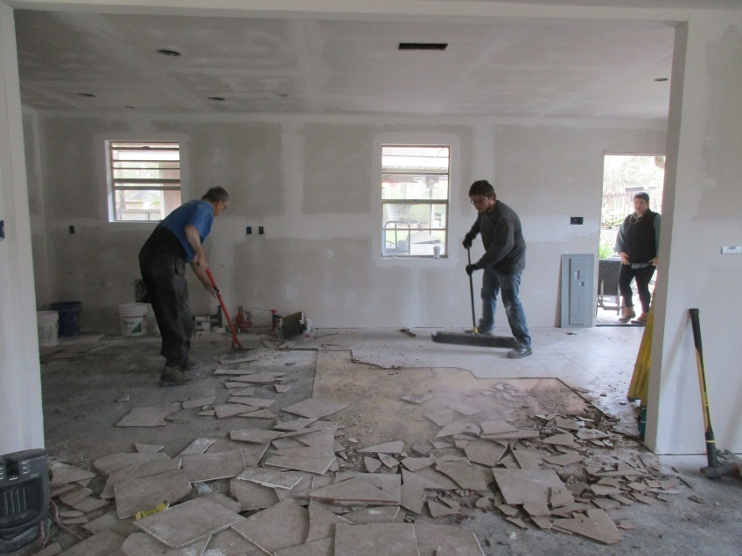
Day 1 – Removing Flooring – brutal work
Shawn starting bedroom
Valerie working in closet
Regan finishes the last piece of tile
Kitchen Tile before and during removal

Slide 5
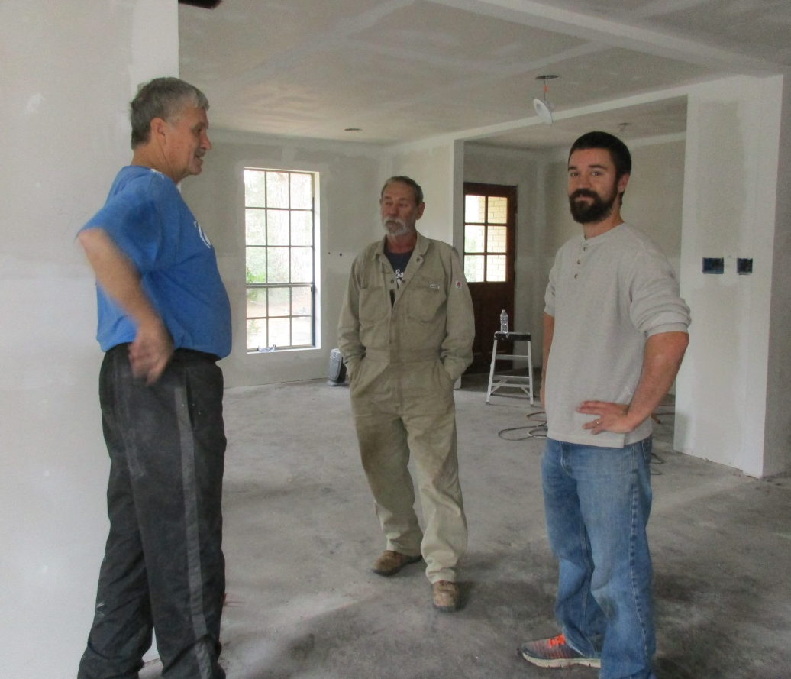
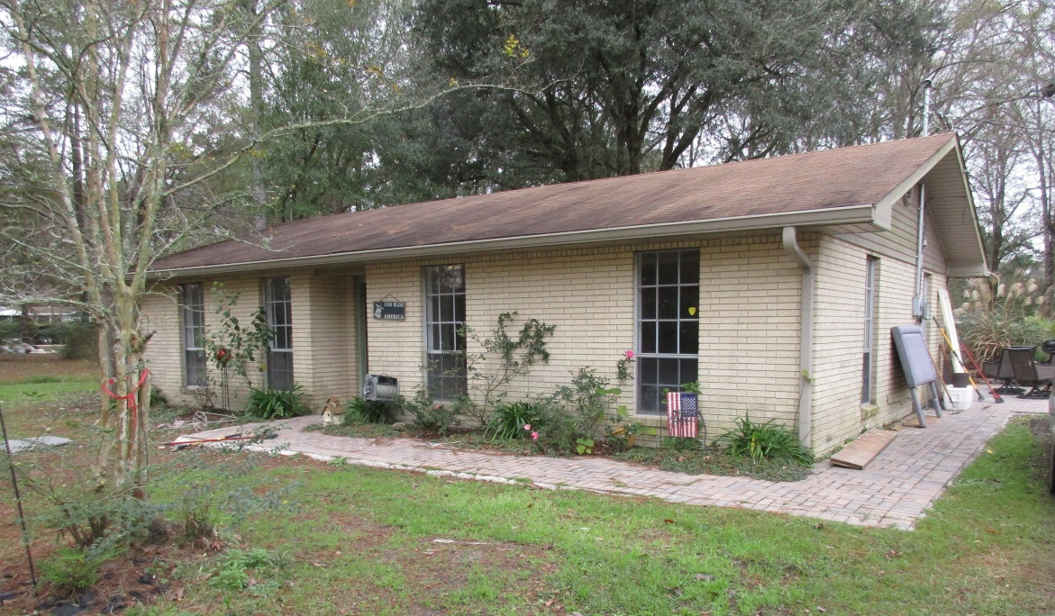
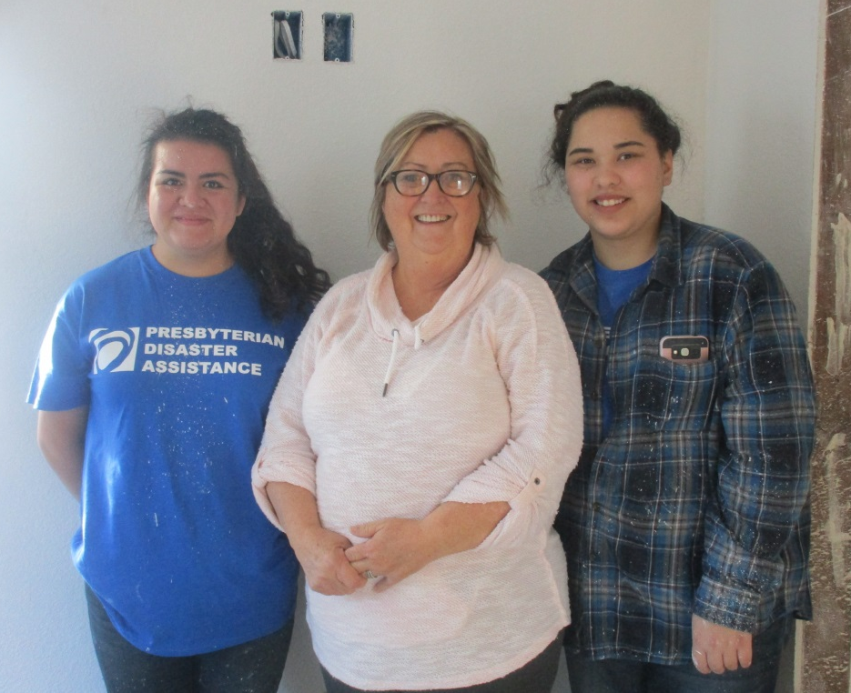
Owners of the House we worked on - Kirby and Judy
Darryl, Kirby (owner), and
Matt (Site Manager)
Regan, Judy (owner), and Valerie

Slide 6
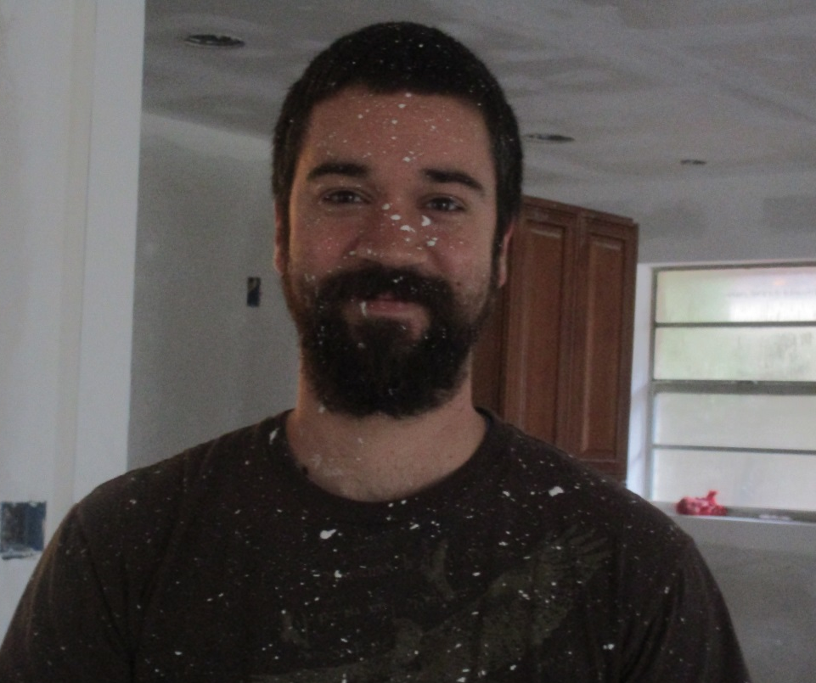
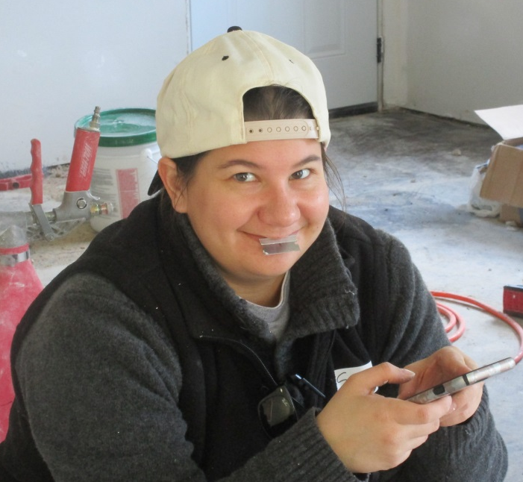
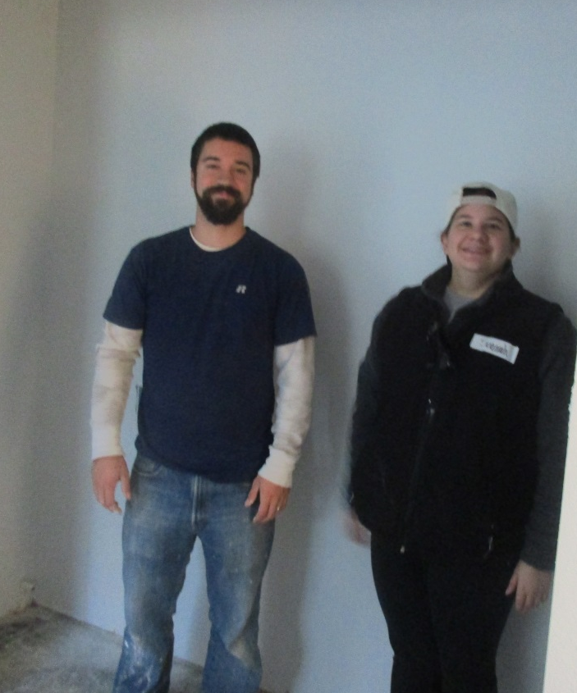
Fuller House Staff arrange the site work
Top: Matt paint spattered,
Savannah with razor blade (why?),
James the other Site Mgr,
Bottom: Matt and Savannah,
and last but not least, Tamara!

Slide 7
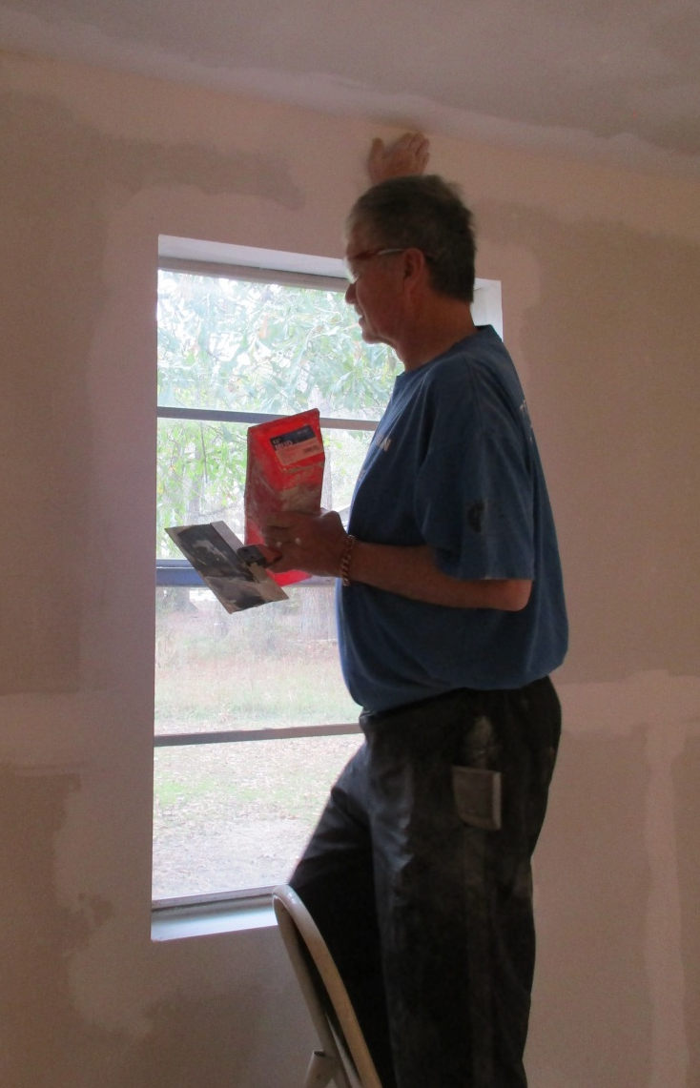
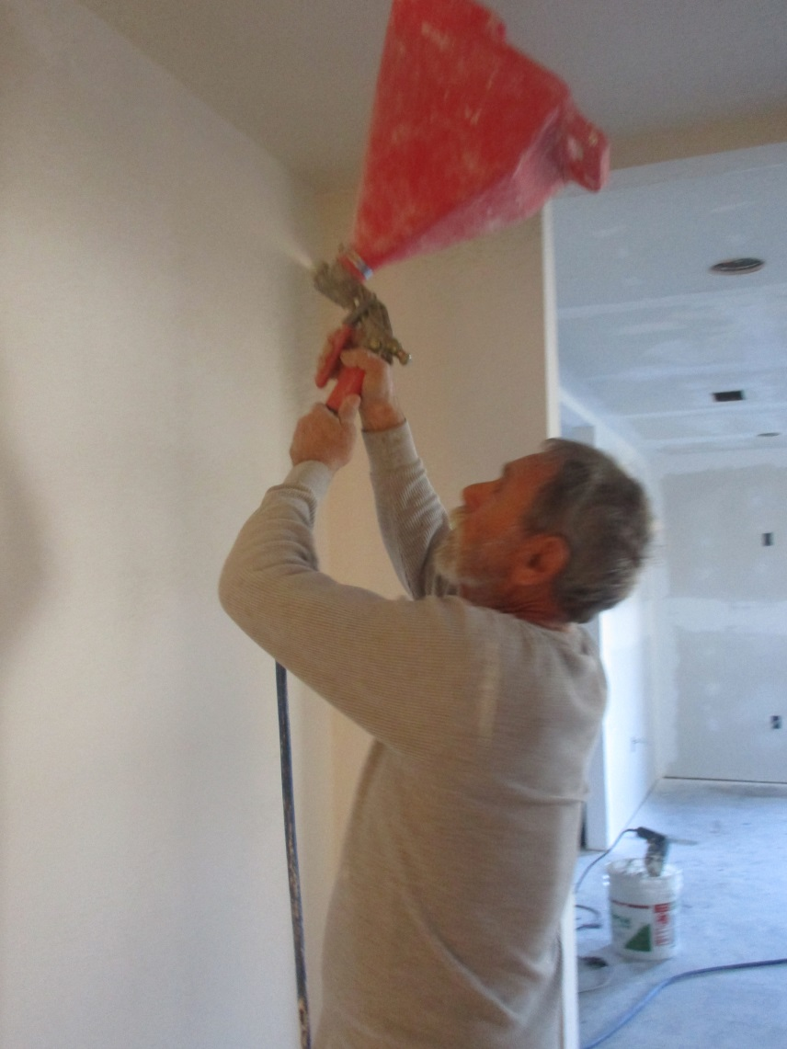
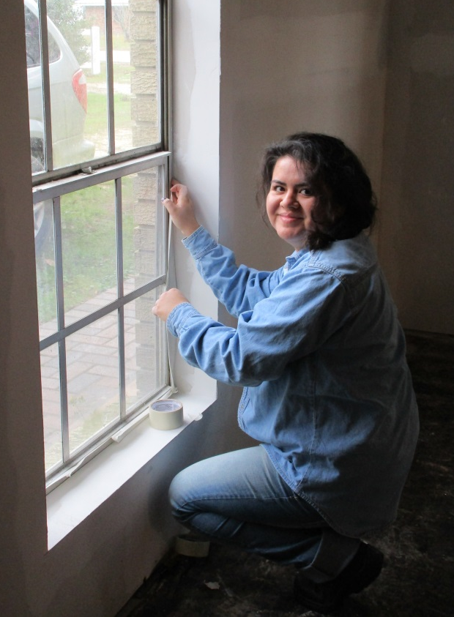
Walls – sand, texture, scrape, prime, paint (repeat endlessly)
Julie sanding, Regan taping,
Darryl sanding and repairing,
Kirby texturing

Slide 8
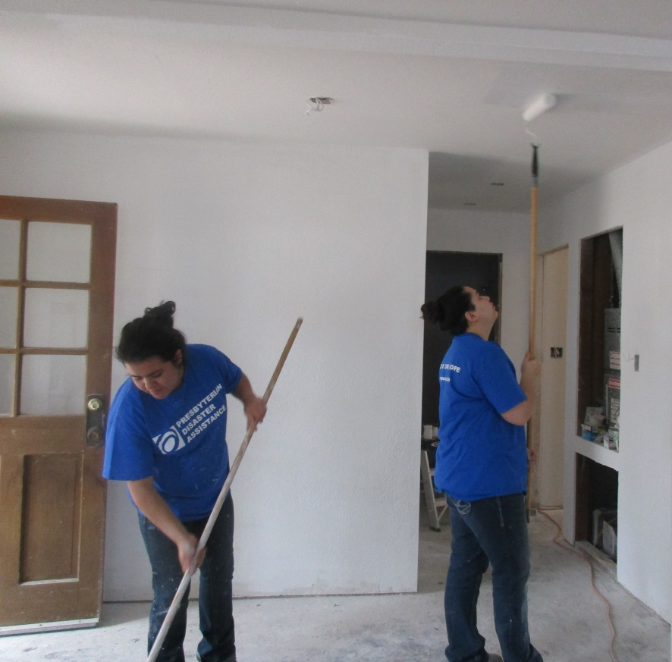
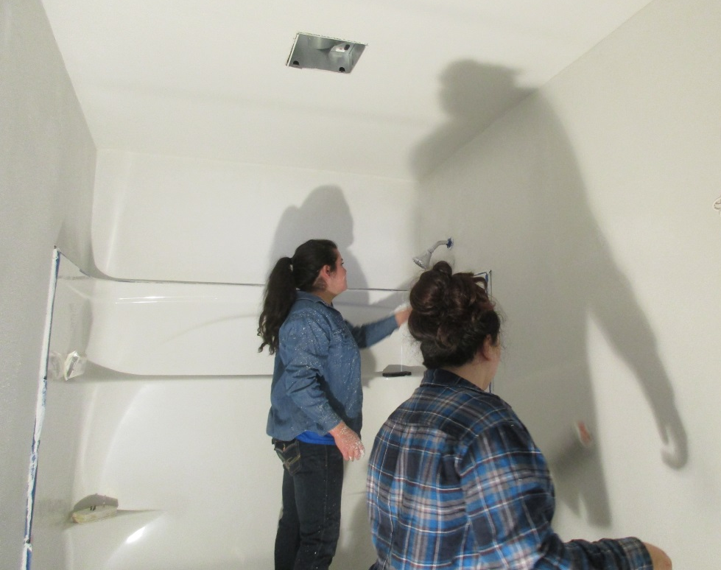
Val and Regan Prime and Paint and Prime and Paint.

Slide 9
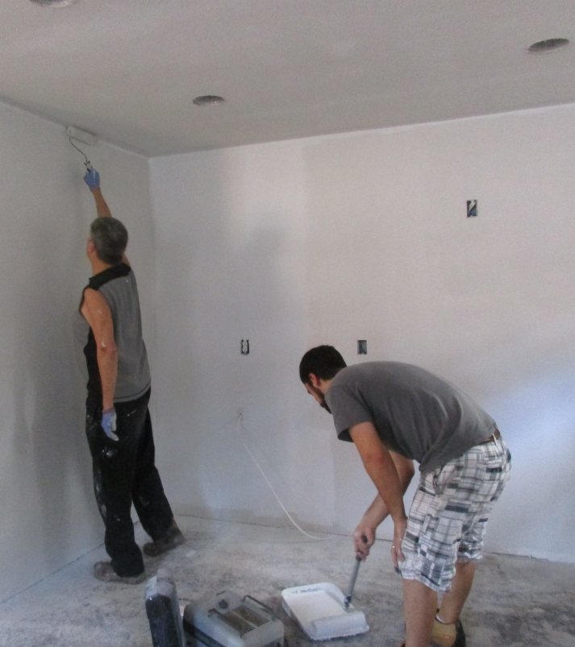
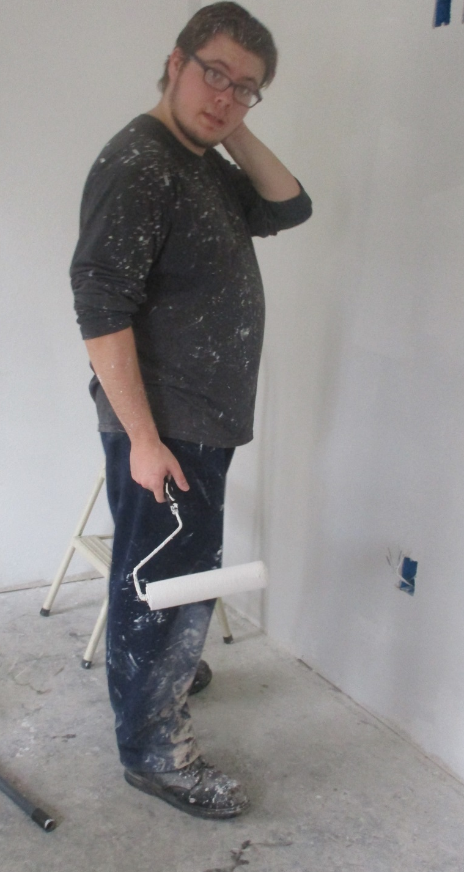
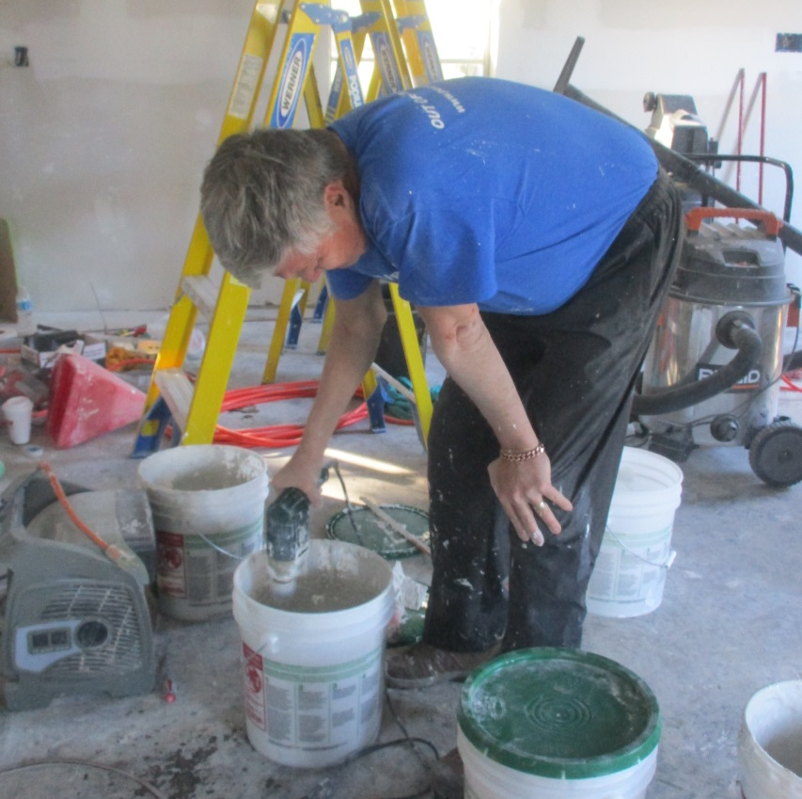
5 Days of Texturing, Priming and Painting!
Shawn, Darryl,
and Matt

Slide 10
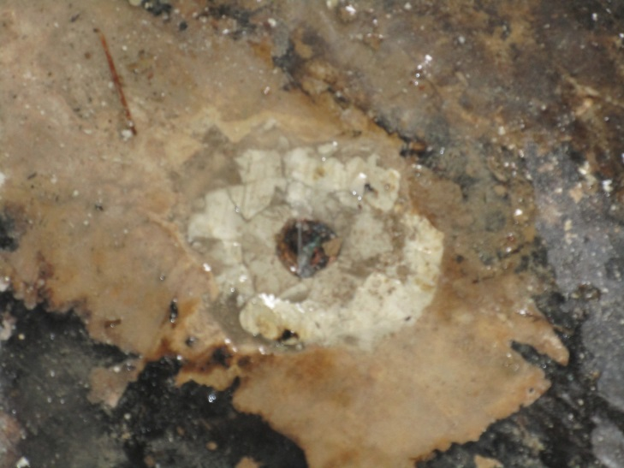
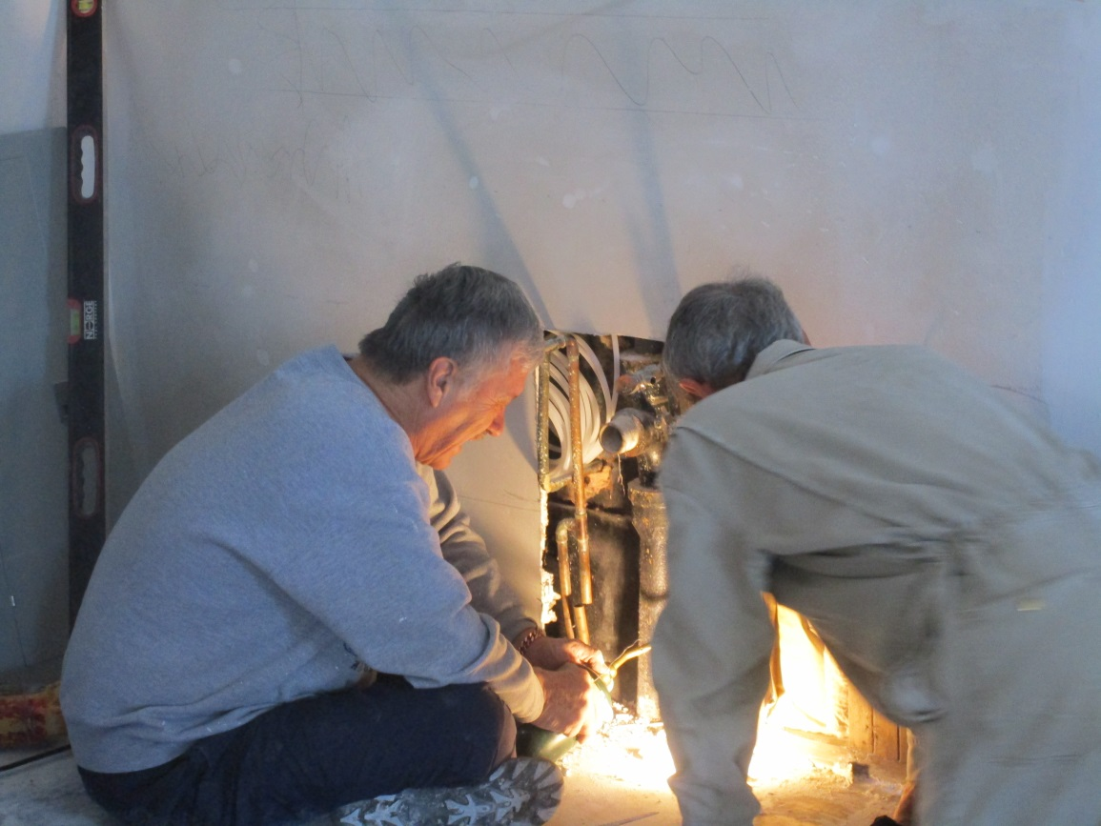
Oops – Plumbing Problem old repair by soldering a penny caused a small geyser and plumbing repairs
Top – photo of mini geyser,
Shawn standing on geyser,
Darryl and Kirby repairing plumbing

Slide 11
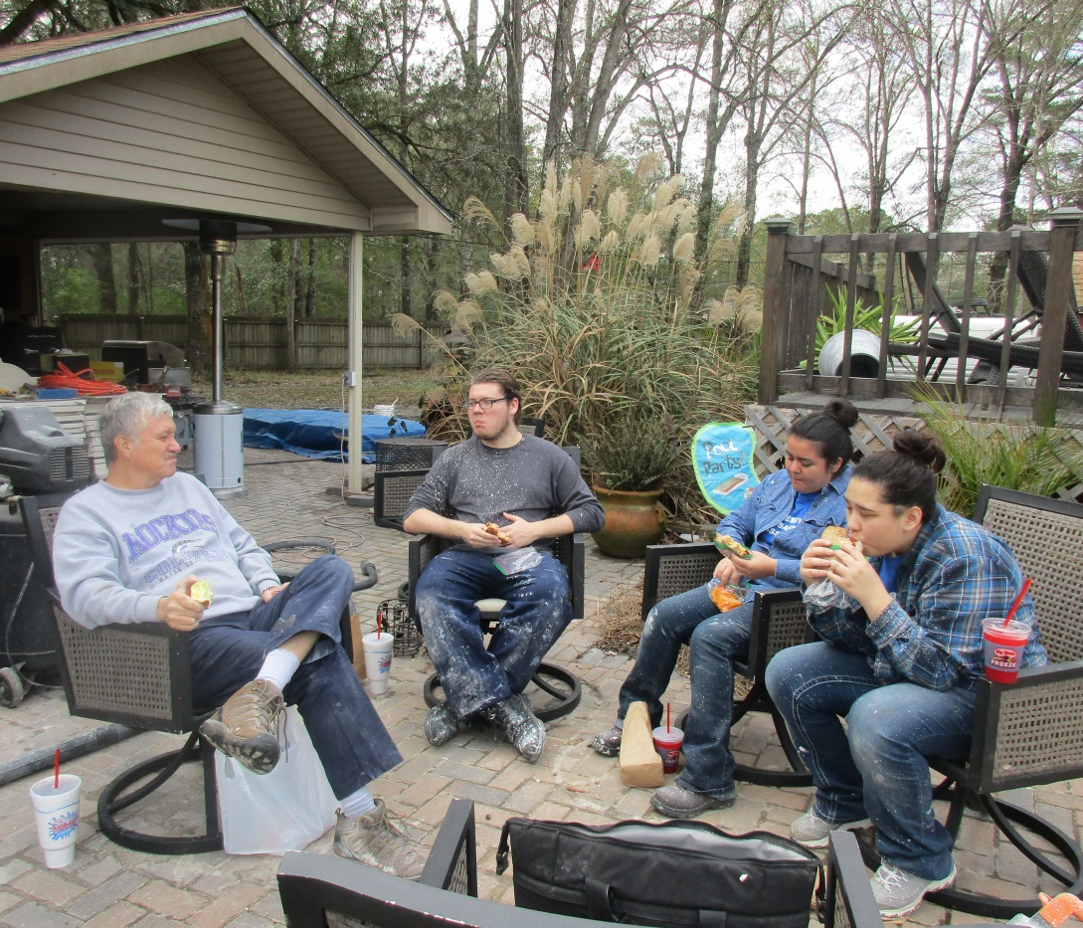
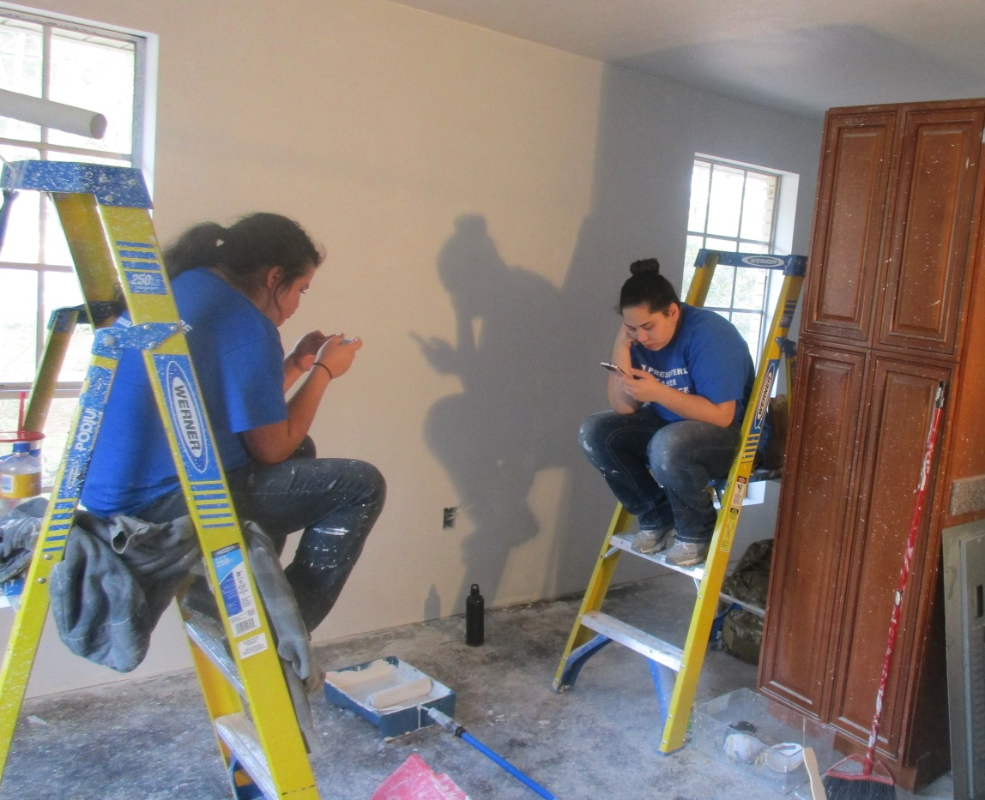
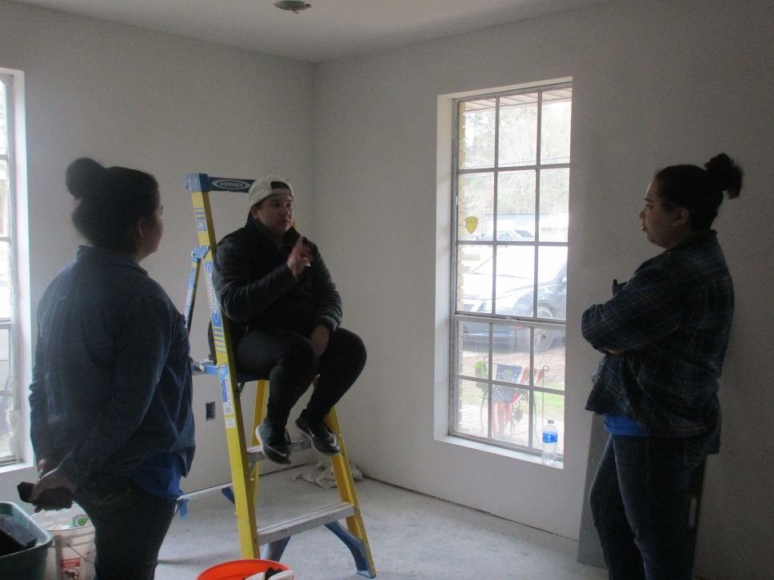
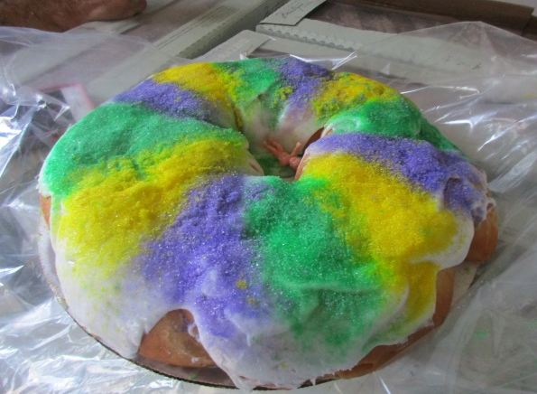
Breaks
Breaks

Slide 12
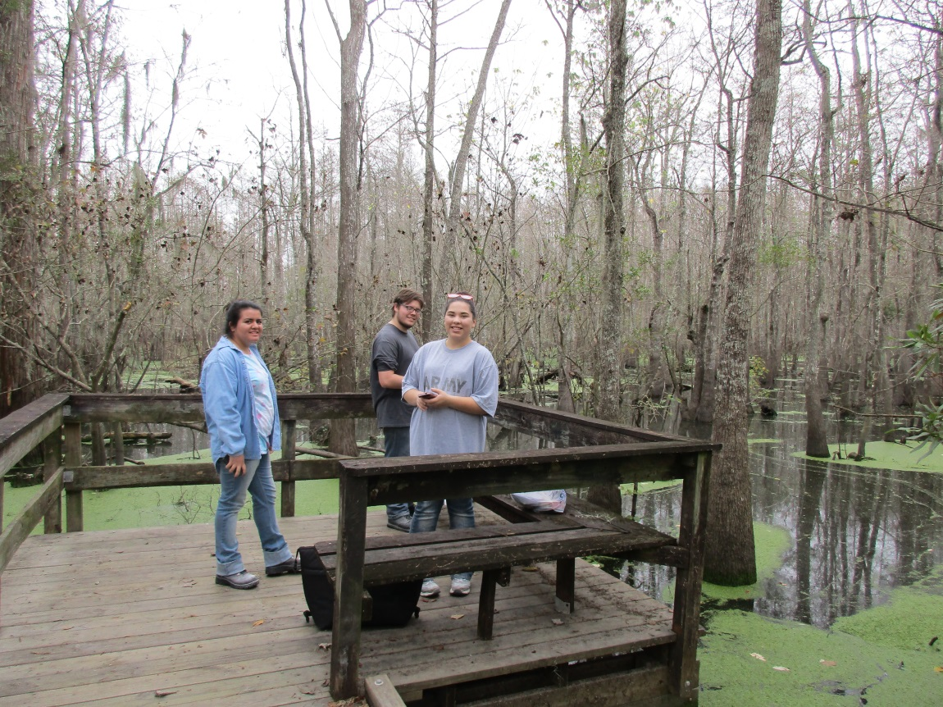
Bayou Lunch/Devotion

Slide 13
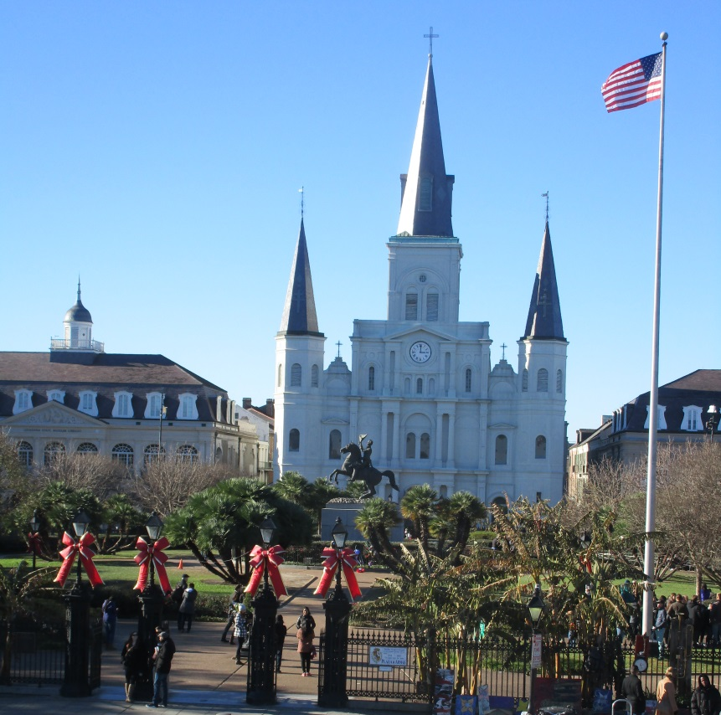
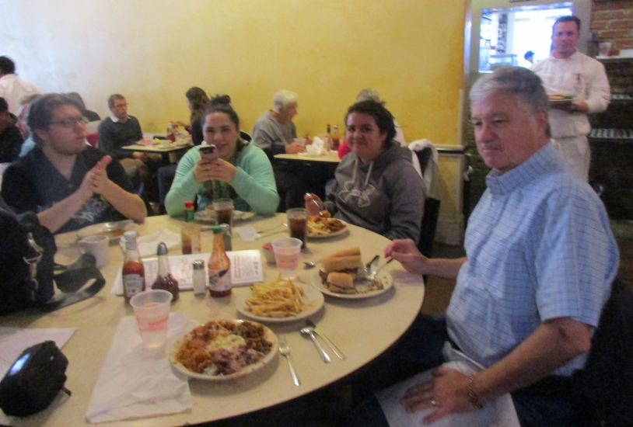
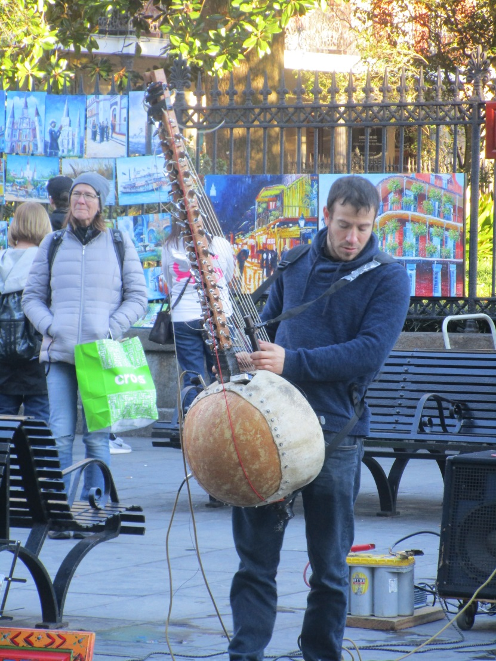
New Orleans Jackson Square Mother’s Restaurant Mississippi River Street Musician

Slide 14
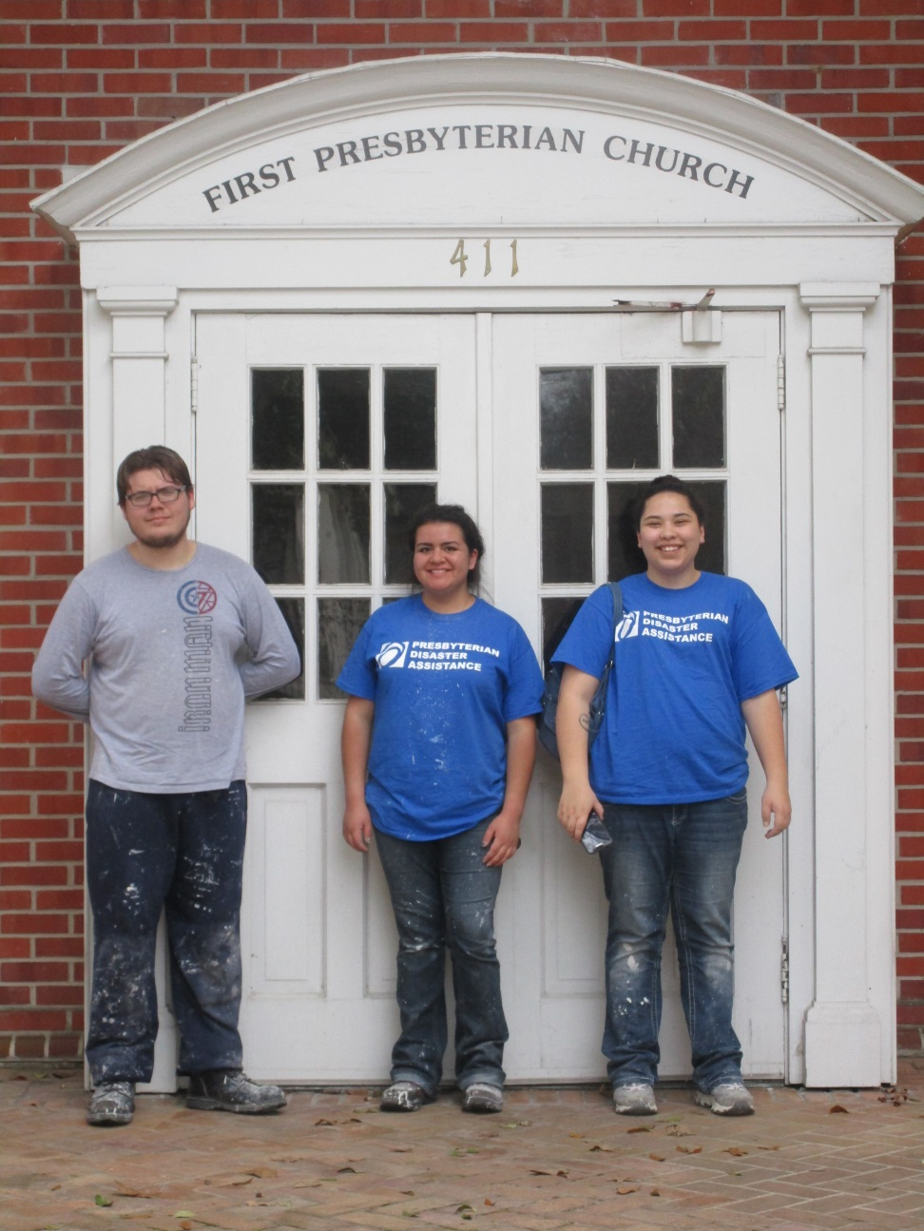
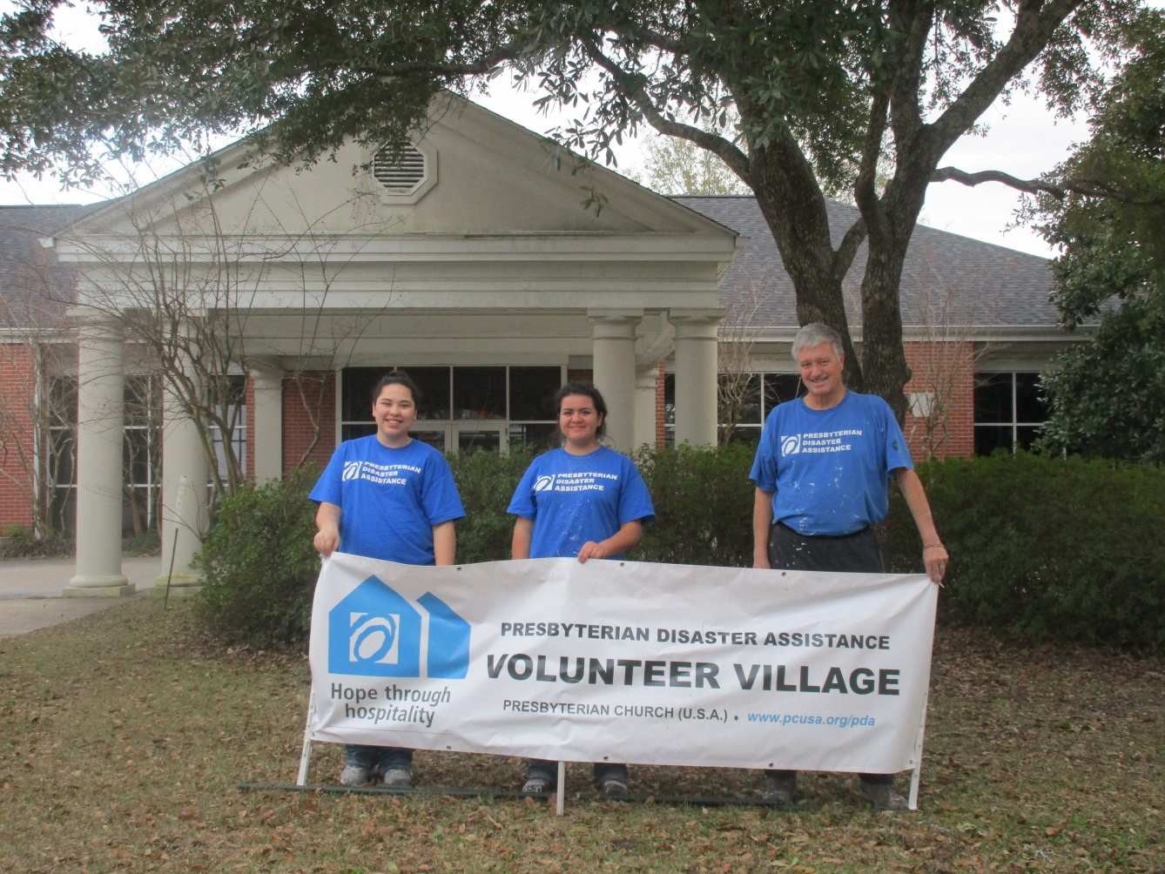
PDA Village – First Presbyterian Church Hammond LA

Slide 15
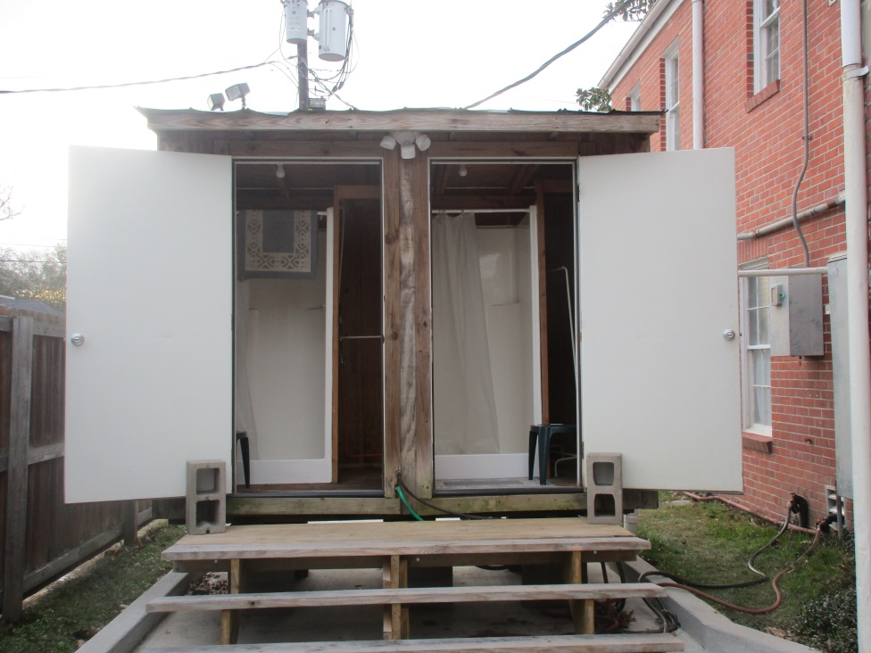
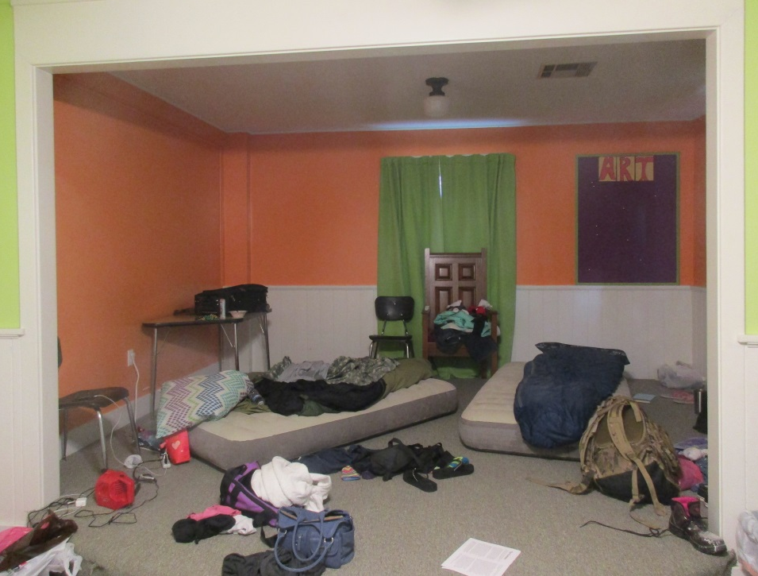
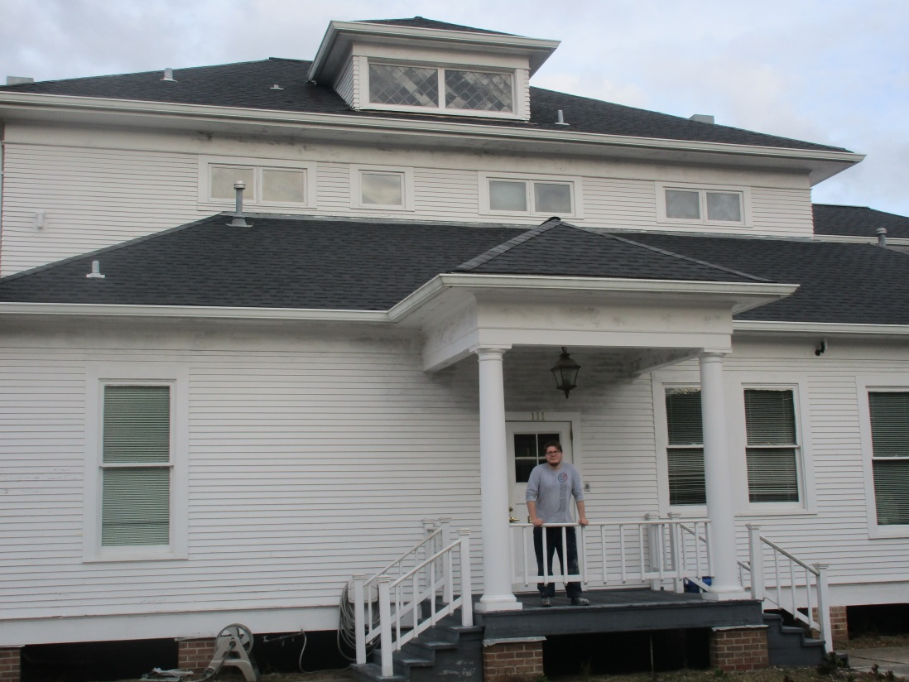
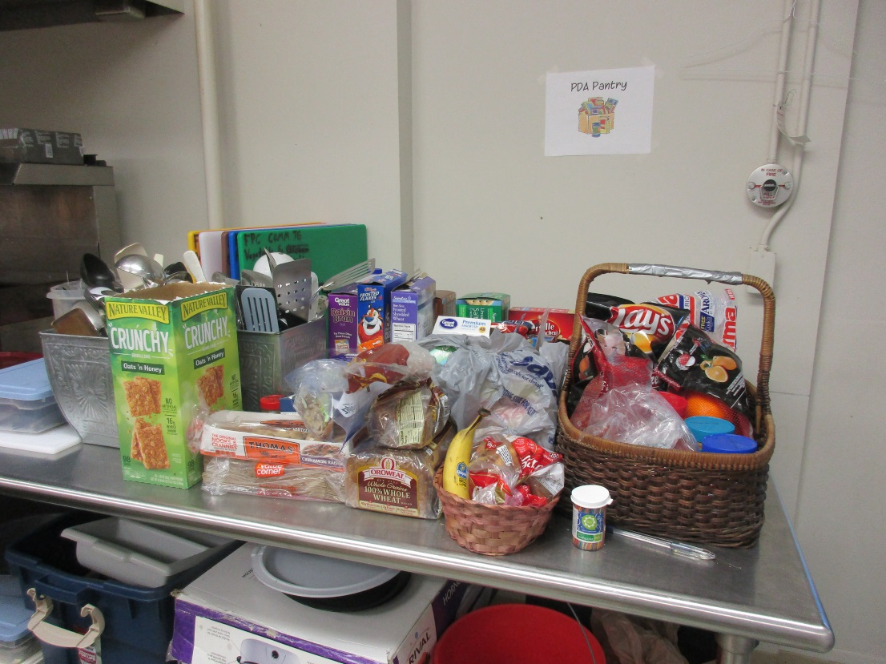
PDA Village
Outdoor Showers, Val & Regan’s room, Presbyterian House (Shawn’s hideout), Food Pantry

Slide 16
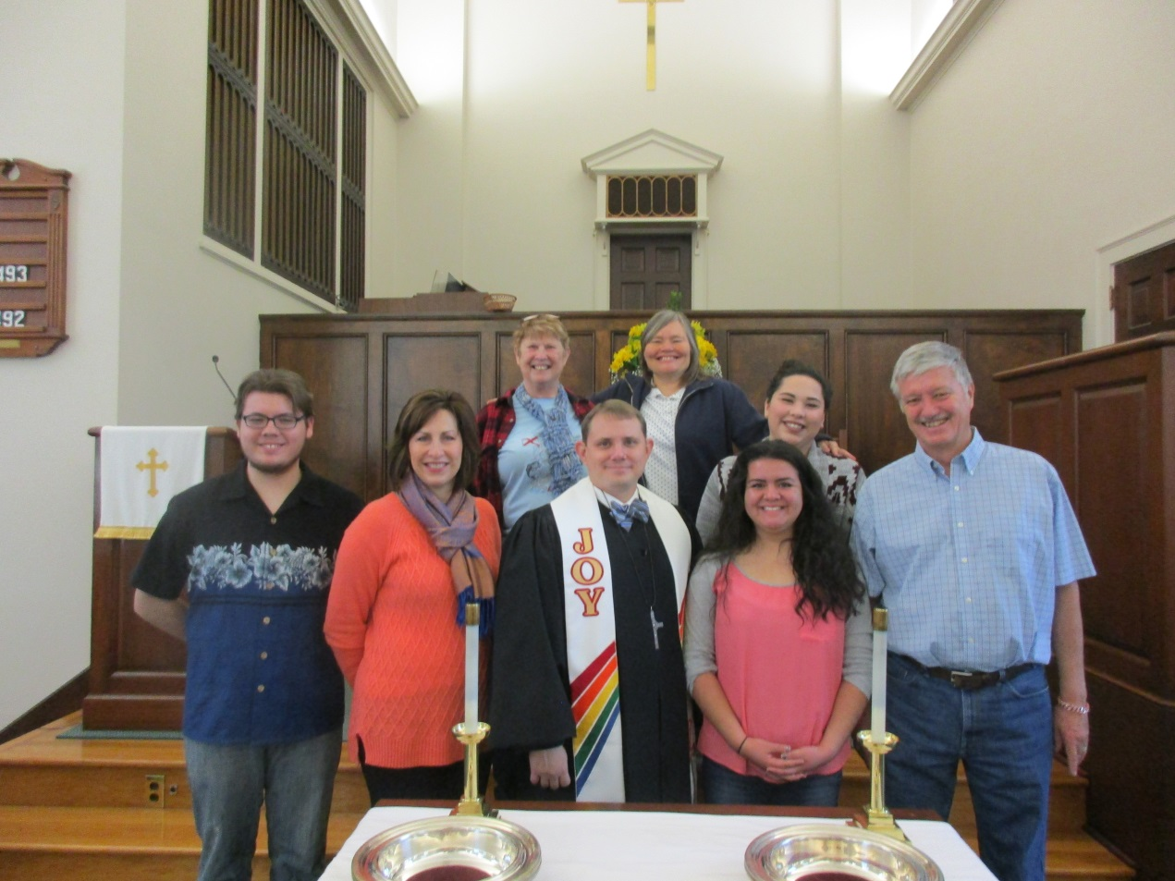
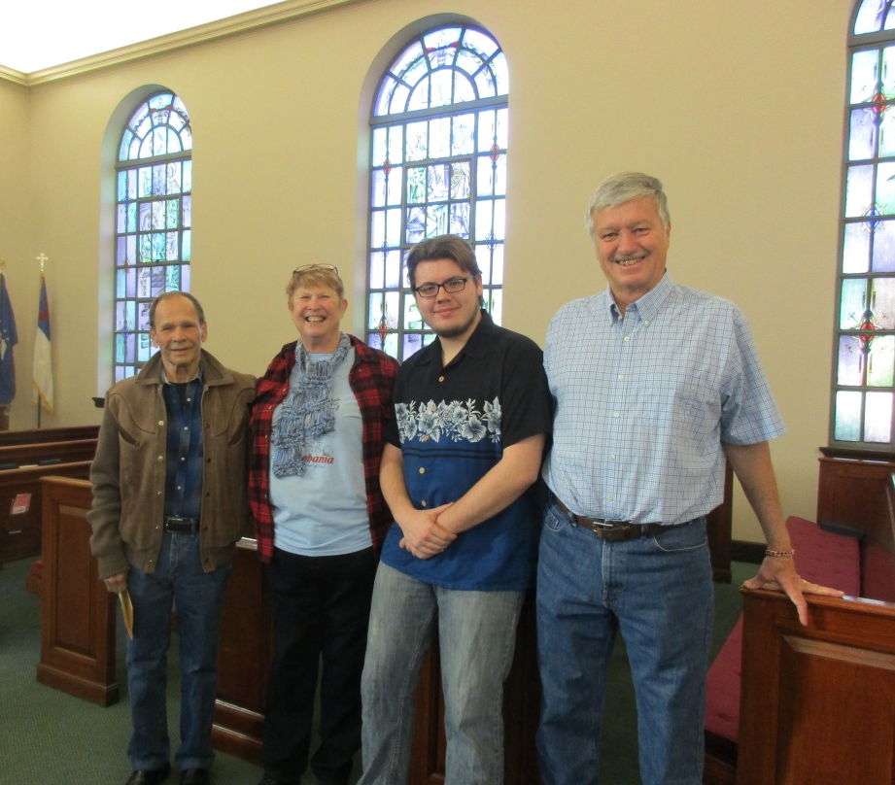
New Friends at First Presbyterian Church in Hammond
Back: Jeanie, Julie, Valerie
Front: Shawn, Tamara, Pastor Barry Chance, Regan, Darryl
Harvey and Jeanie Jones,
Shawn, and Darryl

Slide 17
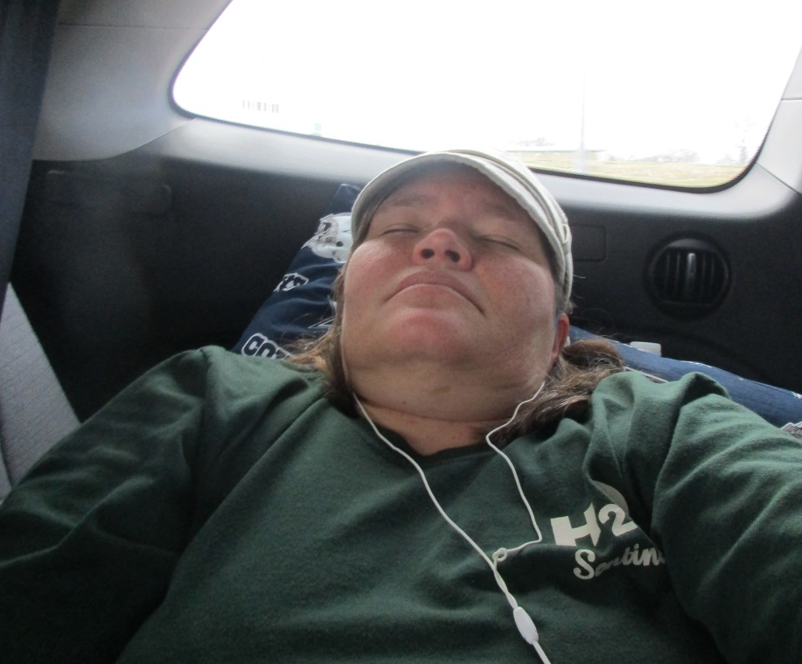
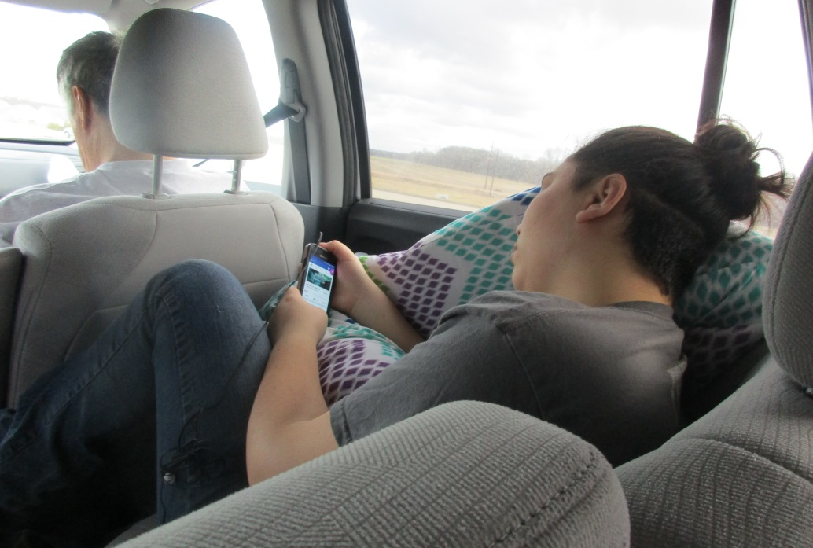
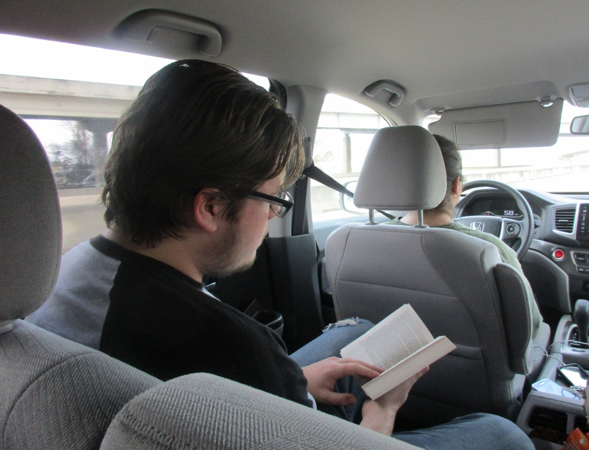
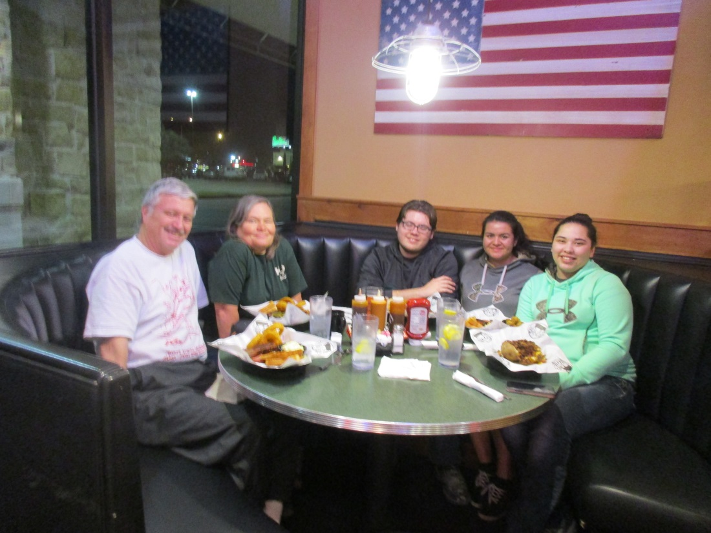
Trip Home

Slide 18
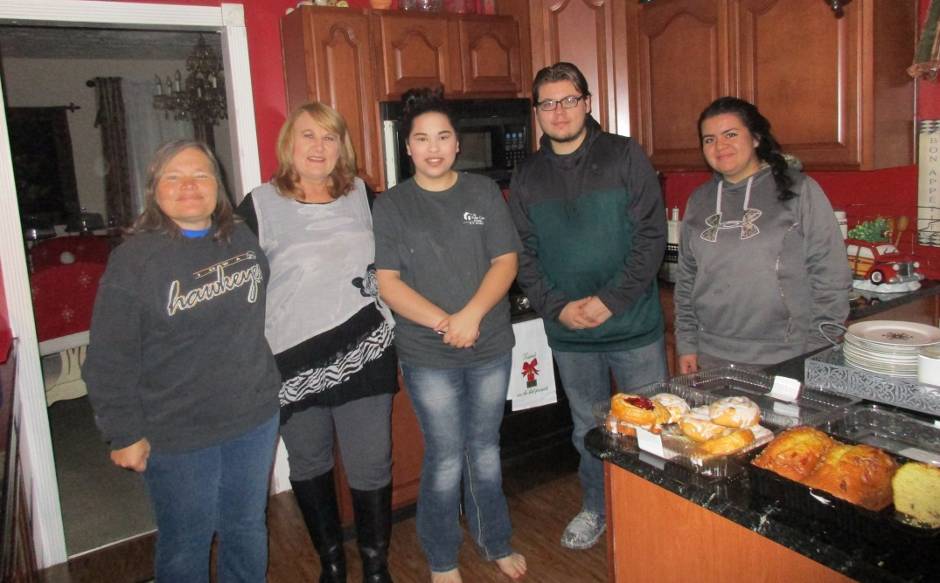
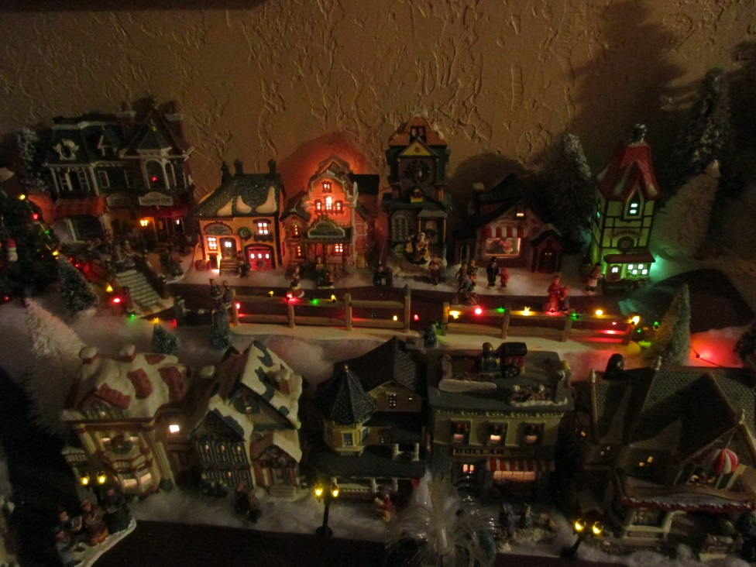
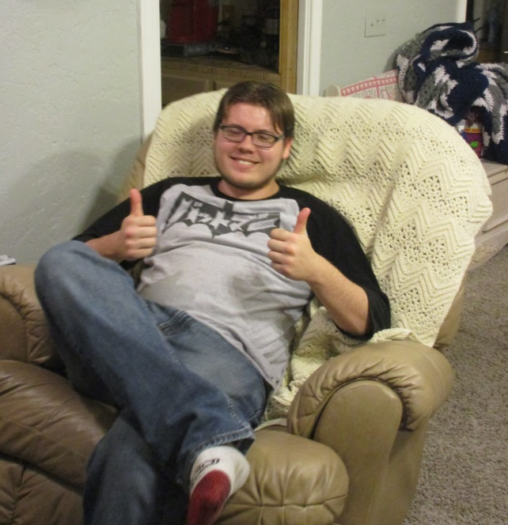
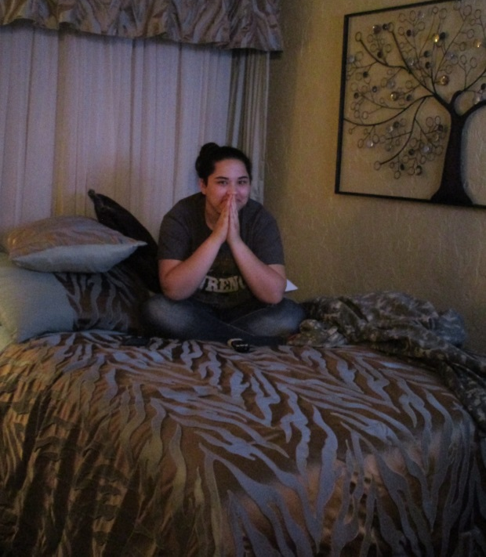
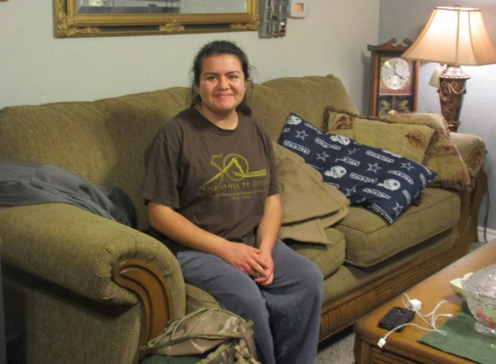
Diane graciously hosted us at her house Faun Presbyterian Church in Wichita Falls
Diane’s house was full of Christmas
Darryl and Julie claimed one bed and
Valerie quickly grabbed the other bed.
Regan took the couch and
Shawn was happy with the recliner.

